Slide 1
IEC 61400 12 series restructure
Proposal to TC88
MT12-1/PCWG Meetings – Frankfurt May 2016
Alan Derrick, RES
Frank Ormel, Vestas

Slide 2
Contents
Introduction
Reasons for Restructuring
Strategic Goals for redeveloping power performance standards
Current Structure
Proposed Structure
Timeline

Slide 3
Introduction
Content of this presentation based on a draft proposal by A Derrick, having been invited to lead the restructuring of the -12 standards by TC88 past chairman Sandy Butterfield.
The work is being discussed with Troels Friis Pedersen (convener of -12-1) and Frank Ormel (convener of -12-2). The work on -12-4 is only starting up and is unlikely to be affected by this restructuring.
TC88 chairmen past & present have commented favourably on the work so far.
In my absence, Frank presented this draft to TC88 in Jeju, South Korea in April 2016.
Standards numbering in this presentation is for convenience only and does not reflect actual future numbers.
This presentation is for information as the discussion is still ongoing and the proposal is not yet final

Slide 4
Reasons for restructuring
The work on the current revision started in January 2009 and is expected to finished early 2017, taking around 8 years to complete.
The work has costed an estimated 1.5 million Euro (based on 100 EUR/hour).
The scope and complexity of the work was under-estimated, which has lead to a highly complex standard of 266 pages.
The request to the maintenance team was to split the document, which the team found difficult/impossible due to the highly complex nature of the revision.
The task of maintaining future revisions of the new edition of 12-1 is likely to be impractical.

Slide 5
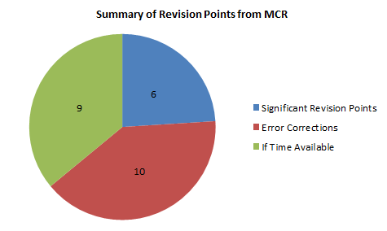
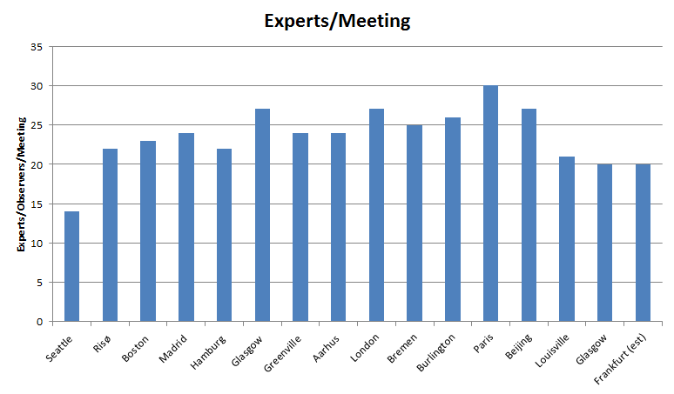
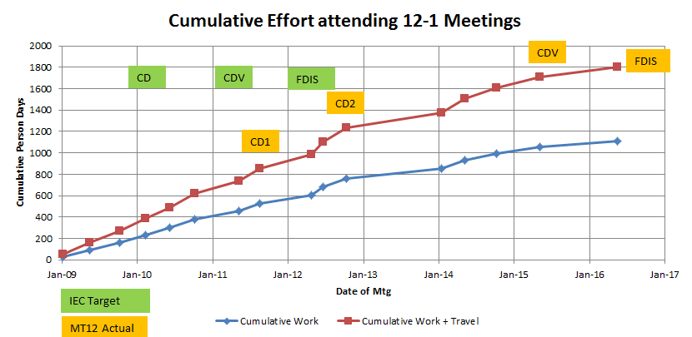
Revision Time Consuming

Slide 6
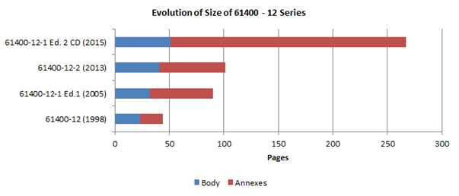
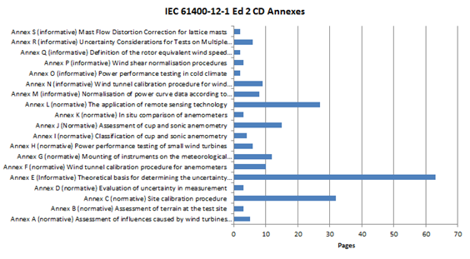
12-1 Edition 2 is Complex!

Slide 7
Strategic development goals
In General:
Reduce time to develop standards – use new technology faster
Reduce complexity of the standard – define clear interfaces
Improved scope management
Specific to the proposed -12 series re-structure:
No technical development as part of restructuring – apart from interface definition
Ideas for future standards /new content to be handled through a future NP approval
Some future goals:
Comprehensive and consistent treatment of uncertainty including all sources of variation on the power curve
Reduce uncertainty of the measurement method
Develop practical approach for a park-level power curve

Slide 8
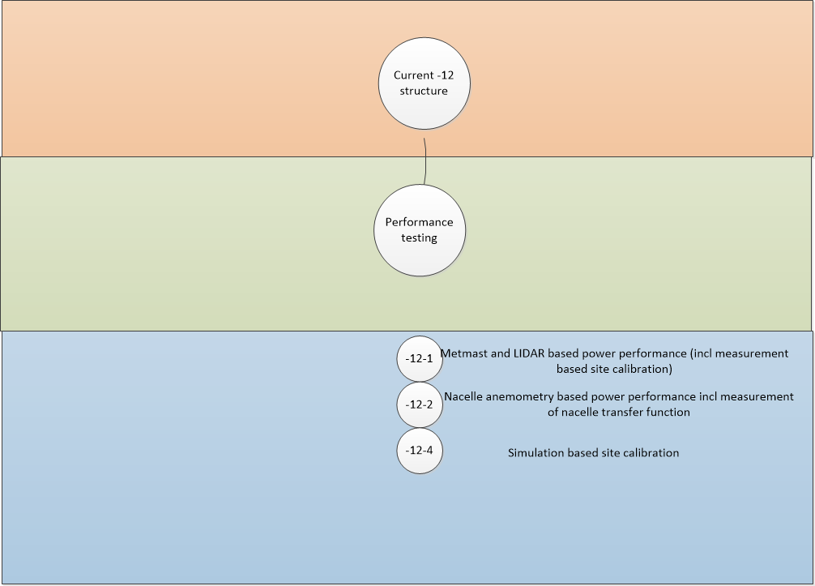
Current structure

Slide 9
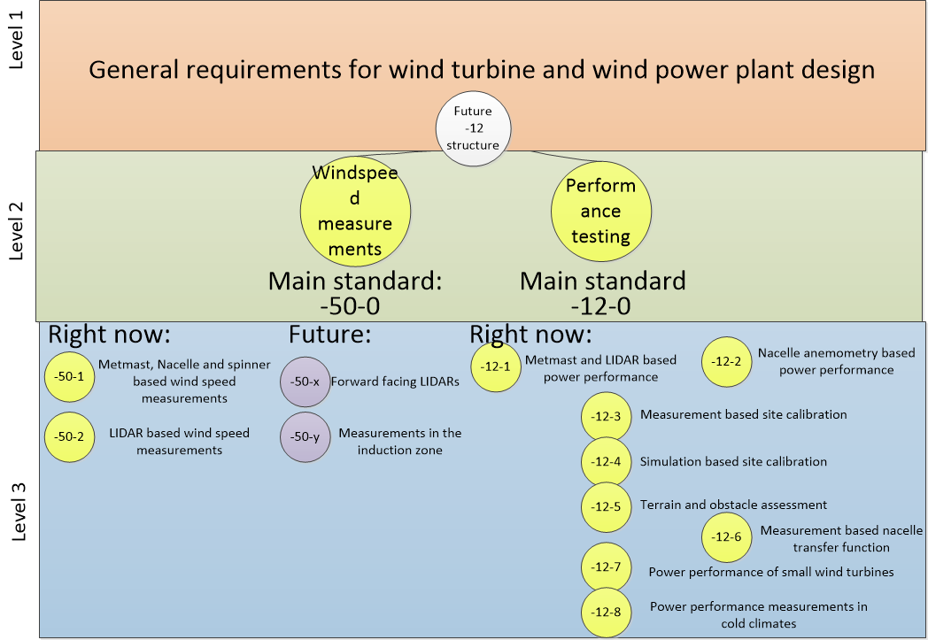
Proposed structure

Slide 10
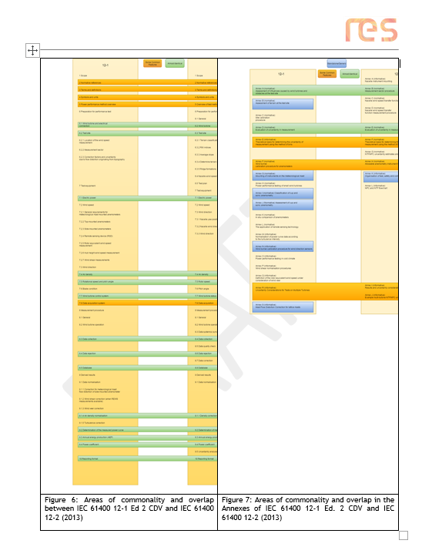
Areas of overlap in 12-1 and 12-2

Slide 11
Documents in the new structure I
Document reference | Short content
-12-0 | General document to align definitions and general concepts for power performance testing. Relevant interfaces from the -101 document, such as the power curve and relevant wind speed definitions, interfaces between lower level standards
-12-1 | Same content as current -12-1 CDV minus: The general introduction (goes to -12-0) The site calibration measurement methodology The wind speed measurement methodology (incl all relevant major annexes)
-12-2 | Same content as the current -12-2 minus: The general introduction The Nacelle Transfer Function measurement methodology The wind speed measurement methodology
-12-3 | Measurement based site calibration (Annex C of -12-1 CDV)
-12-4 | Numerical site calibration (ongoing work on new Technical Report

Slide 12
Documents in the new structure II
Document reference | Keywords
-12-5 | Terrain and Obstacle Impacts on Wind and Power Curve Measurements. Relevant content from -12-1 CDV and -12-2 standards.
-12-6 | Measurement of Nacelle Transfer Function. Annex D from -12-2
-12-7 | Power performance measurements on small wind turbines. Specific standard to address requirements from -2 standard
-12-8 | Power perfromance measurements in cold climates: relevant content from -12-1 CDV to be further developed in the future.
-50-1 | Wind speed measurements using sensors mounted on met masts, wind turbines nacelles and wind turbine spinners
-50-2 | Wind speed measurements using Remote Sensing Devices

Slide 13
Benefits of a restructure of 61400-12 series
Benefits
Restrictions in scope of revisions Those aspects which standalone in separate documents and which are mature are clearly excluded from the scope of a revision on another part of the standard series such that the work remains focussed and may involve smaller, more efficient teams.
Speed of revision Revisions of individual documents of limited scope can be very focussed and implemented more quickly, satisfying the time limit requirements of IEC.
Reduced Duplication New standards can unambiguously refer to clear and specific standalone documents (e.g. use of met masts for wind measurement) without re-writing identical, similar or contradictory text.

Slide 14
Challenges to restructure of 61400-12 series
Challenges
Divergence of Scope There is a risk that if different parts of the standard series are being updated in parallel by possibly different groups of people then they may diverge unless there is tight management of scope by TC88.
Scope Management A very well thought out and managed relationship between the various documents is required which although desirable, may be onerous to manage and administer.
Demands on Experts Revising many separate parts to the standard series may require more time/meetings from the same experts.
Time/Scheduling To be effective and efficient, the re-structure must be carried out as a single step and as a breakpoint in the technical evolution of the -12 series of standards. Buy-in from those pushing for further, immediate technical evolution is required.
The re-structure must be carried our coherently and with the support of TC88 and PT-101

Slide 15
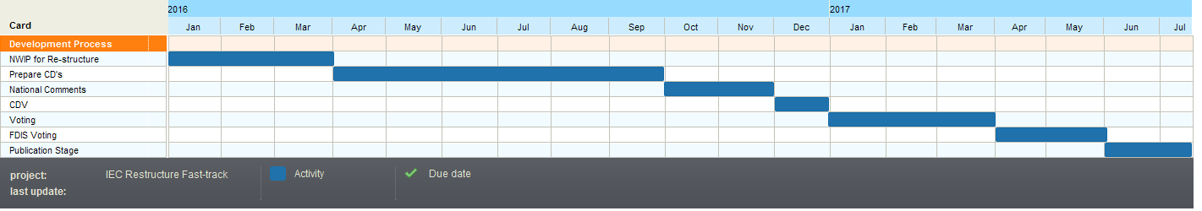
Estimated Timescales for re-structure
However TC88 chairman, Jeroen van Dam, has suggested (in a personal communication dated 1st March 2016) that an even faster process may be possible if the text of the existing approved contributing standards (12-1 ed 2 and 12-2) is submitted as the CD together with the NP describing the re-structure and with the strict condition that no technical changes are to be allowed. It should therefore be possible to move to a CDV more quickly and if the CDV is 100% approved, the FDIS stage can be skipped.

Slide 16
What is next?
12-1 Ed. 2 FDIS needs to be finished!
Refinement of re-structure proposal
circulate to MT12-1 and 12-2
Harmonisation/collaboration with PT101
Buy-in from MT12-1 and 12-2
Approval of NP by TC88

Slide 17


Slide 18
Splitting existing 12-1 (ed 2) and 12-2 content
NOTE – this is purely an illustration of the concept, not the plan

